Slide 1
T863203 LOCATION TECHNOLOGIES
POSITIONING IN MOBILE NETWORKS
Senior Lecturer Riitta Rontu, M.Sc (Eng.)
Oulu University of Applied Sciences

Slide 2
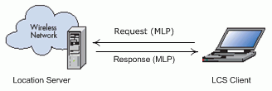
The Placement of LCS in the Network
LCS (Location Services) applications can be placed in different elements in mobile systems:
  in the operator’s network’s platform
  in mobile station
  as an external client e.g. in the internet
Location Technologies 2014 /RR
1.4.2014

Slide 3
Terms
LCS client: a software/hardware entity that interacts with a LCS server to obtain location information for LCS target. Sends a request to the LCS server to obtain location information.
LCS target: a mobile phone (or other subject) that is being located
LCS server: a physical or logical entity that manages positioning for a LCS target device
  Collects measurements and other location information
  Assists the UE in calculations
  Estimates the UE location
Location Technologies 2014 /RR
1.4.2014

Slide 4
Location Methods in GSM networks
In Live GSM networks, three location methods are supported:
  Cell-ID + TA + sector info
  E-OTD
  AGPS
Location Technologies 2014 /RR
1.4.2014

Slide 5
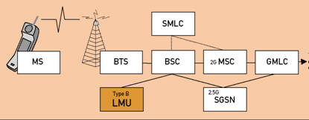
LMU’s (Location Measurement Unit) are needed in GSM base stations to collect the location information from mobiles when using E-OTD or OTDOA methods
Location Technologies 2014 /RR
1.4.2014

Slide 6
Location Methods in UMTS networks
All the previously mentioned location methods were discussed in the 3GPP and next three methods were selected:
  Cell ID based positioning
  Observed Time Difference of Arrival (OTDOA) (based on TDOA principle)
  Assisted GPS positioning
Location Technologies 2014 /RR
1.4.2014

Slide 7
OTDOA-IPDL
OTDOA-IPDL: OTDOA-Idle Period Downlink:
  If mobile is too close to serving BS, it may cause hearability problems to other BS’s signals.
  IPDL improves this situation : serving BS ceases its transmission for short periods of time (idle periods) and during these periods the mobile can measure other BS’s signals and also the RTD’s more accurately.
OTDOA-IPDL is used in UMTS networks. It is considered to give even 10 m accuracy in rural and suburban environment.
Location Technologies 2014 /RR
1.4.2014

Slide 8
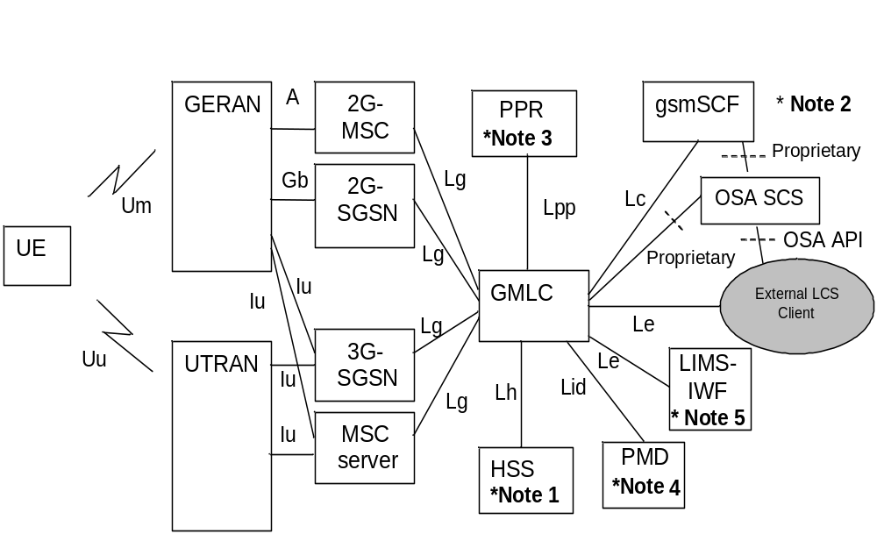
LCS Architecture in 3GPP Specs
Location Technologies 2014 /RR
1.4.2014

Slide 9
The Gateway Mobile Location Center (GMLC) is the actual network element, which controls and performs the positioning process and receives the location requests from LCS clients
A LCS client makes a request to the GMLC for the location information of one or more than one target mobile
Location Technologies 2014 /RR
1.4.2014

Slide 10
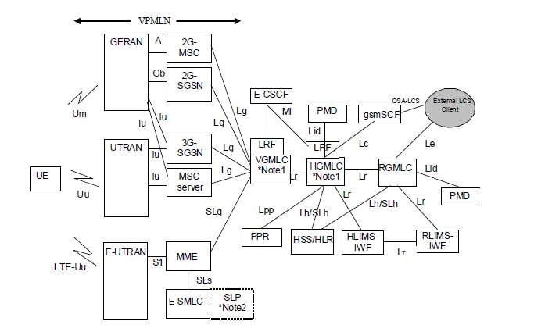
LCS Architecture in 3GPP Specs with LTE
Location Technologies 2014 /RR
1.4.2014

Slide 11
Comparison of different positioning methods
Positioning method | Cell-ID+TA | EOTD | OTDOA | GPS | AGPS
Accuracy | Bad | Medium | Medium | Very good | Excellent
Speed (TTFF) | Excellent | Very good | Very good | Bad | Very good
Battery durability | Excellent | Good | Good | Good | Medium
Expenses | Very small | Small | Small | Small | Small
Summary | Good, but very bad accuracy | Medium | Good | Good | Very good
1.4.2014
Location Technologies 2014 /RR

Slide 12
Conclusions on different methods
Cell based methods (CI, EOTD, OTDOA): the accuracy of these methods is not adequate even in the heavy urban areas. In the rural area the accuracy is even poorer. On the contrary, these methods are really fast and battery saving.
AGPS seems to be the most promising method of all these possibilities; AGPS beats GPS in many cases (accuracy, speed, power) and it is more accurate than cell based methods.
Location Technologies 2014 /RR
1.4.2014

Slide 13
Ethical aspects
The positioning of a mobile user does always need a permission from the person that is positioned.
Many kinds of problems can occur if positioning is possible without this permission.
Location Technologies 2014 /RR
1.4.2014

Slide 14
The legislation concerning mobile positioning is unfinished in most of the countries.
Usually there are some laws about positioning in case of emergency and prevention of criminal or terrorist acts.
There should be a well-defined legislation and practical rules about the use of positioning data before the producing, marketing and selling of the location-based services really begins in large scale.
Location Technologies 2014 /RR
1.4.2014

Slide 15
Governmental surveillance: The Big Brother is watching You!
The mobile phone is the easiest way to control society members, because nowadays almost every active citizen has a mobile with him! Also it is possible to control big crowds of people at the same time.
Different countries have different laws about the surveillance of the citizens.
Location Technologies 2014 /RR
1.4.2014

Slide 16
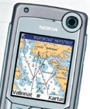
Future visions
The infotainment services, navigation and entertainment services are predicted to be the most frequently used services in the mobile networks in the future.
These services will be all-inclusive only when they are properly localised
Location Technologies 2014 /RR
1.4.2014

Slide 17
Killer application?
The mobile network operators are expecting that the location-based services are going to be the killer application e.g. in 3G networks in the near future.
That means higher speed, quality and accuracy demands for the positioning transaction.
AGPS is the most promising positioning method at the moment, but supposedly there will be more efficient methods developed in the future
Location Technologies 2014 /RR
1.4.2014

